Slide 1
CORONA VIRUS ANALYSIS.
BY WALUSIMBI SILVER.

Slide 2
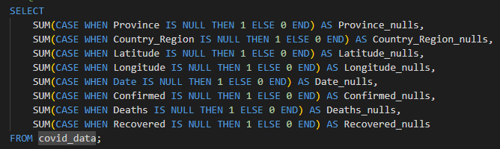
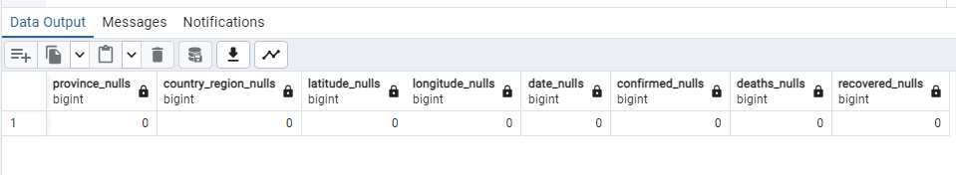
Check null values.

Slide 3
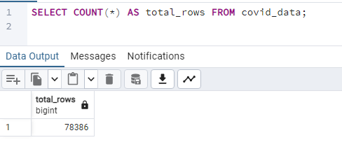
Check total number of rows

Slide 4
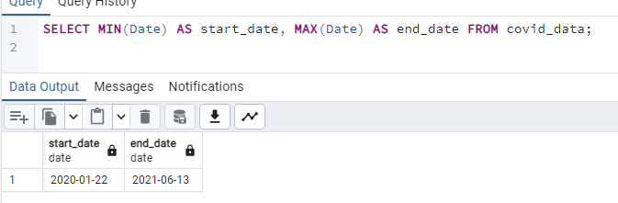
Check what is start_date and end_date

Slide 5
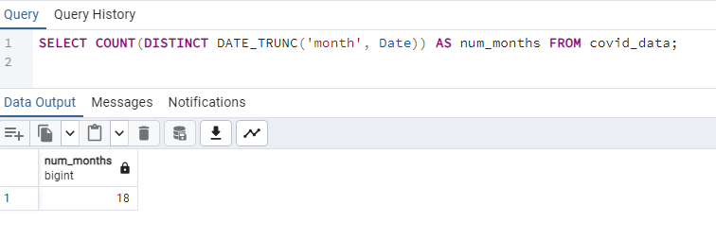
Number of months present in dataset

Slide 6
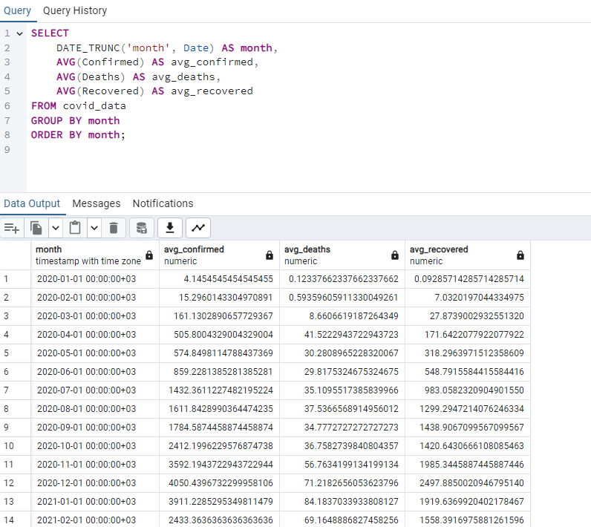
Monthly average for confirmed, deaths, recovered

Slide 7
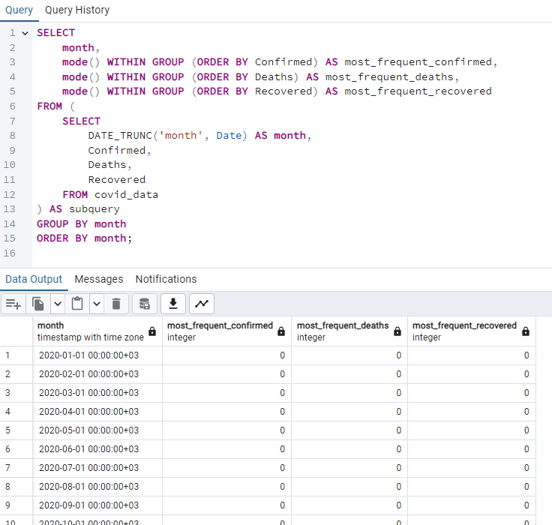
Most frequent value for confirmed, deaths, recovered each month

Slide 8
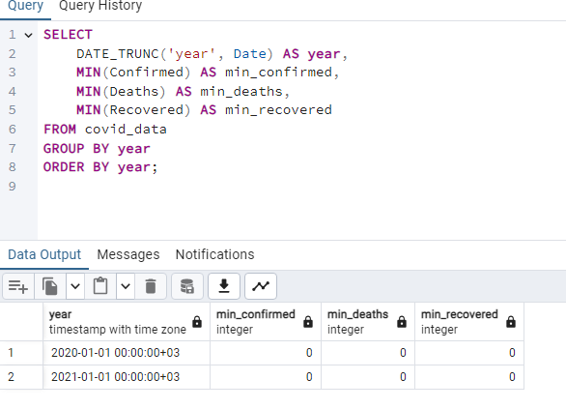
Minimum values for confirmed, deaths, recovered per year

Slide 9
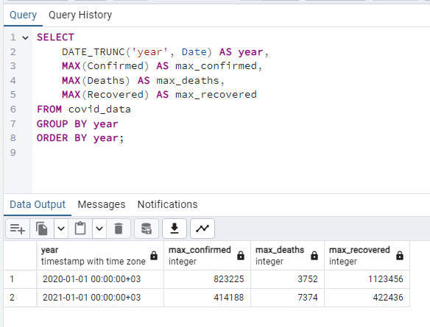
Maximum values for confirmed, deaths, recovered per year

Slide 10
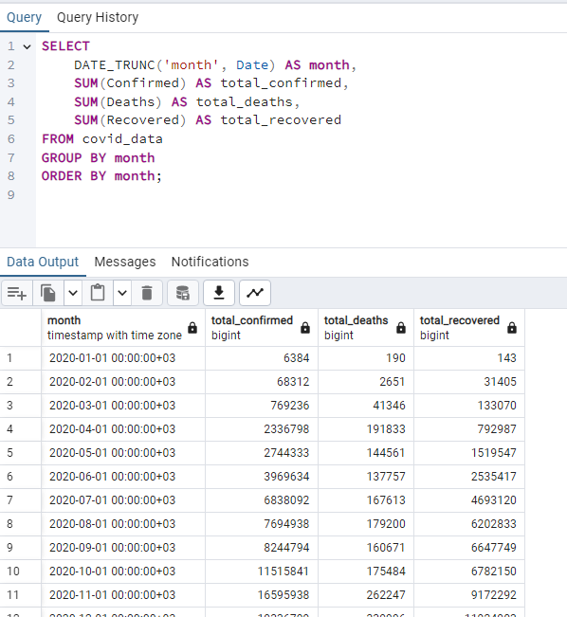
Total number of case of confirmed, deaths, recovered each month

Slide 11
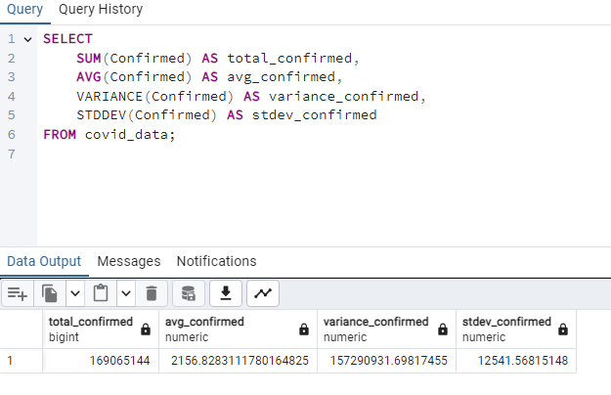
How corona virus spread out with respect to confirmed case

Slide 12
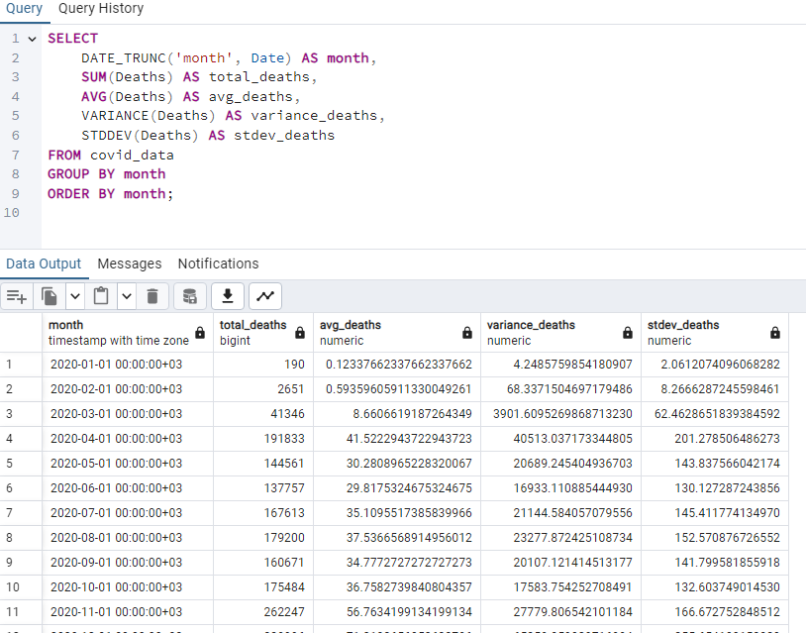
How corona virus spread out with respect to death case per month

Slide 13
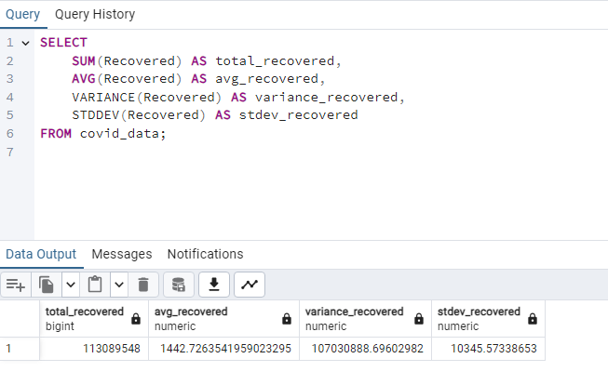
How corona virus spread out with respect to recovered case

Slide 14
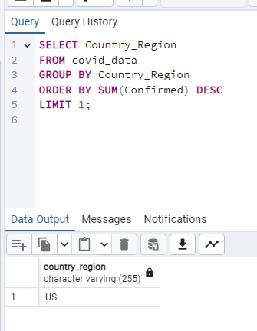
Country having highest number of the Confirmed case

Slide 15
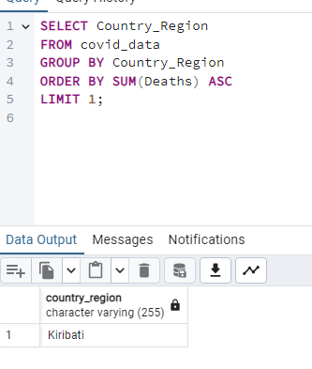
Country having lowest number of the death case

Slide 16
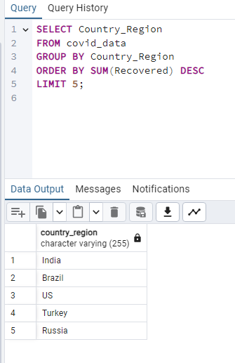
Top 5 countries having highest recovered case

